Slide 1
GIT
Dr. Leon Jololian

Slide 2
Installing GIT on Windows
The most official build is available for download on the Git website: http://git-scm.com/download/win
To test version:
git --version
Git comes with a tool called git config that lets you get and set configuration variables that control all aspects of how Git looks and operates.
After installing Git, set your user name and email address:
git config --global user.name "John Doe"
git config --global user.email "johndoe@example.com"

Slide 3
Configuring the default text editor
To configure the editor on the system:
git config --global core.editor "'C:\Program Files\TextPad 8\TextPad.exe' -m"
To check your settings:
git config --list
To check a particular setting:
git config user.name
To unset a config value:
git config --global --unset core.editor

Slide 4
To edit the config file:
git config --global --edit
Windows uses both a carriage-return character and a linefeed character for newlines in its files, whereas Mac and Linux systems use only the linefeed character.
On a Windows machine, set core.autocrlf to true — this converts LF endings into CRLF:
git config --global core.autocrlf true

Slide 5
Getting Help
To get the manual page for any of the Git commands:
git help <verb>
git <verb> --help
man git-<verb>
For example, to get the manpage help for the config command:
git help config

Slide 6
Initializing a Repository in an Existing Directory
cd to the project’s directory
Type: git init
This creates a new subdirectory named .git that contains all of your necessary repository files – a Git repository skeleton. At this point, nothing in your project is tracked yet.
To start version-controlling existing files:
git add *.java
git add data.txt
git commit -m 'project version 1'

Slide 7
Cloning an Existing Repository
To get a copy of an existing Git repository – for example, a project to which you will be contributing:
git clone https://github.com/libgit2/libgit2
It creates a directory named “libgit2”, initializes a .git directory inside it, pulls down all the data for that repository, and checks out a working copy of the latest version.
The new libgit2 directory, has the project files in there, ready to be worked on or used.
To clone the repository into a directory with a different name, we can specify the directory name as a command-line option:
git clone https://github.com/libgit2/libgit2 mylibgit

Slide 8
Recording Changes to the Repository
Each file in the working directory can be in one of two states:
Tracked or Untracked.
Tracked files are files that were in the last snapshot: they can be unmodified, modified, or staged.
Untracked files are everything else: any files in the working directory that were not in the last snapshot and are not in the staging area.
When you first clone a repository, all of the files will be tracked and unmodified because Git just checked them out and you haven’t edited anything.

Slide 9
The Three States of a File
Git has three main states that your files can reside in: committed, modified, and staged:
Committed means that the data is safely stored in your local database.
Modified means that you have changed the file but have not committed it to your database yet.
Staged means that you have marked a modified file in its current version to go into your next commit snapshot.

Slide 10
Central Repository
Local Repository
V.2
Push
V.1
V.1
Commit
Working
Directory
Staging
Area
File 3
File 2
Add
File 1
File 1

Slide 11
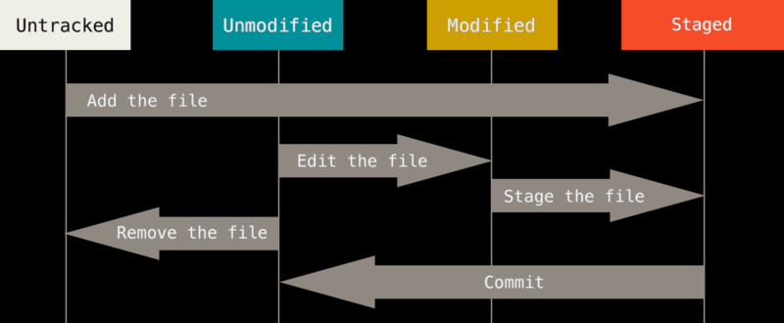
The lifecycle of the status of your files

Slide 12
Checking the Status of Files
To determine the state of a file, use the git status command. If you run this command directly after a clone, you should see something like this:
git status
On branch master
Your branch is up-to-date with 'origin/master'.
nothing to commit, working directory clean
This means none of your tracked files are modified
Git also doesn’t see any untracked files, or they would be listed here.
The command tells you which branch you’re on and informs you that it has not diverged from the same branch on the server.

Slide 13
If you add a new file (e.g. README ) to your project, assuming the file
didn’t exist before, and run git status:
echo 'My Project' > README
git status
On branch master
Your branch is up-to-date with 'origin/master'.
Untracked files:
(use "git add <file>..." to include in what will be committed)
README
nothing added to commit but untracked files present (use "git add"
to track)

Slide 14
Tracking New Files
In order to begin tracking a new file, you use the command git add:
git add README
If you run the status command again:
git status
On branch master
Your branch is up-to-date with 'origin/master'.
Changes to be committed:
(use "git reset HEAD <file>..." to unstage)
new file: README

Slide 15
Staging Modified Files
If we change a previously tracked file called CONTRIBUTING.md and then run the git status command again:
git status
On branch master
Your branch is up-to-date with 'origin/master'.
Changes to be committed:
(use "git reset HEAD <file>..." to unstage)
new file: README
Changes not staged for commit:
(use "git add <file>..." to update what will be committed)
(use "git checkout -- <file>..." to discard changes in working directory)
modified: CONTRIBUTING.md

Slide 16
Let’s run git add now to stage the CONTRIBUTING.md file, and then run git status again:
git add CONTRIBUTING.md
git status
On branch master
Your branch is up-to-date with 'origin/master'.
Changes to be committed:
(use "git reset HEAD <file>..." to unstage)
new file: README
modified: CONTRIBUTING.md
Both files are staged and will go into the next commit.

Slide 17
Suppose you make changes to CONTRIBUTING.md before you commit it:
vim CONTRIBUTING.md
git status
On branch master
Your branch is up-to-date with 'origin/master'.
Changes to be committed:
(use "git reset HEAD <file>..." to unstage)
new file: README
modified: CONTRIBUTING.md
Changes not staged for commit:
(use "git add <file>..." to update what will be committed)
(use "git checkout -- <file>..." to discard changes in working directory)
modified: CONTRIBUTING.md

Slide 18
If you modify a file after you run git add, you have to run git add again to stage the latest version of the file:
git add CONTRIBUTING.md
git status
On branch master
Your branch is up-to-date with 'origin/master'.
Changes to be committed:
(use "git reset HEAD <file>..." to unstage)
new file: README
modified: CONTRIBUTING.md

Slide 19
Short Status
The git status output is comprehensive and wordy.
Git has a short status flag to see changes in a compact way:
git status -s
git status --short
Example:
git status -s
M README
MM Rakefile
A lib/git.rb
M lib/simplegit.rb
? ? LICENSE.txt

Slide 20
New files that aren’t tracked have a ?? next to them.
New files that have been added to the staging area have an A
Modified files have an M.
There are two columns to the output - the left-hand column indicates the status of the staging area and the right-hand column indicates the status of the working tree.
In the example, the README file is modified in the working directory but not yet staged, while the lib/simplegit.rb file is modified and staged. The Rakefile was modified, staged and then modified again, so there are changes to it that are both staged and unstaged.

Slide 21
Ignoring Files
Often, you’ll have a class of files that you don’t want Git to automatically add or even show you as being untracked. These are generally automatically generated files such as log files or files produced by your build system. In such cases, you can create a file listing patterns to match them named .gitignore. Here is an example .gitignore file:
cat .gitignore
*.[oa]
*~
The first line tells Git to ignore any files ending in “.o” or “.a”. The second line tells Git to ignore all files whose names end with a tilde (~). You may also include a log or tmp.
The rules for the patterns you can put in the .gitignore file are as follows:
Blank lines or lines starting with # are ignored.
Standard glob patterns work.
You can start patterns with a forward slash (/) to avoid recursivity.
You can end patterns with a forward slash (/) to specify a directory.
You can negate a pattern by starting it with an exclamation point (!).

Slide 22
Example .gitignore File
# no .a files
*.a
# but do track lib.a, even though you're ignoring .a files above
!lib.a
# only ignore the TODO file in the current directory, not subdir/TODO
/TODO
# ignore all files in the build/ directory
build/
# ignore doc/notes.txt, but not doc/server/arch.txt
doc/*.txt
# ignore all .pdf files in the doc/ directory
doc/**/*.pdf

Slide 23
Undoing Things
One of the common undos takes place when you commit too early and possibly forget to add some files, or you mess up your commit message.
If you want to redo that commit, make the additional changes you forgot, stage them, and commit again using the --amend option:
git commit --amend
For example, if you commit and then realize you forgot to stage the changes in a file you wanted to add to this commit, you can do something like this:
git commit -m 'initial commit’
git add forgotten_file
git commit --amend

Slide 24
Unstaging a Staged File
let’s say you’ve changed two files and want to commit them as two separate changes, but you accidentally type git add * and stage them both. How can you unstage one of the two? The git status command reminds you:
git add *
git status
On branch master
Changes to be committed:
(use "git reset HEAD <file>..." to unstage)
renamed: README.md -> README
modified: CONTRIBUTING.md

Slide 25
If we decide to unstage the CONTRIBUTING.md file:
git reset HEAD CONTRIBUTING.md
Unstaged changes after reset:
M CONTRIBUTING.md
git status
On branch master
Changes to be committed:
(use "git reset HEAD <file>..." to unstage)
renamed: README.md -> README
Changes not staged for commit:
(use "git add <file>..." to update what will be committed)
(use "git checkout -- <file>..." to discard changes in working directory)
modified: CONTRIBUTING.md

Slide 26
Unmodifying a Modified File
What if you realize that you don’t want to keep your changes to the CONTRIBUTING.md file? How to revert back to what it looked like when you last committed (or initially cloned)?
The git status tells you how to do. In the last example output, the unstaged area looks like this:
Changes not staged for commit:
(use "git add <file>..." to update what will be committed)
(use "git checkout -- <file>..." to discard changes in working directory)
modified: CONTRIBUTING.md
git checkout -- CONTRIBUTING.md
git status
On branch master
Changes to be committed:
(use "git reset HEAD <file>..." to unstage)
renamed: README.md -> README

Slide 27
To undo the latest changes to working directory:
git checkout -- <file>
To undo changes to all the files:
git checkout -- .
To undo committed changes:
git revert <commit id> it also does a commit
git revert –n <commit id> reverts without a commit
To remove all commits after a specific commit:
git reset --hard <commit id>

Slide 28
Branches
List all branches: git branch
Create a new branch: git branch <new branch>
To activate a particular branch: git checkout <branch>

Slide 29
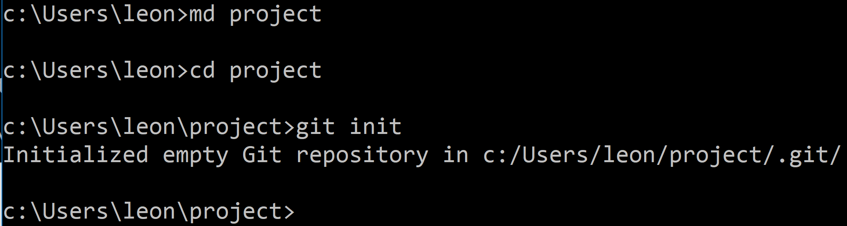
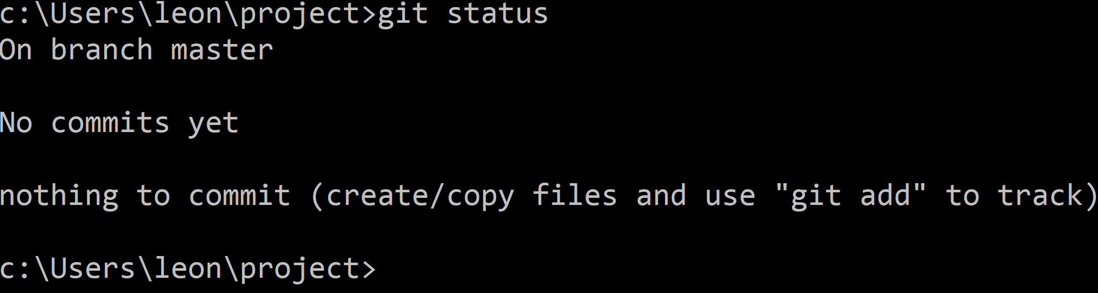
1) Create a new folder and initialize a git repository:
2) Check status:

Slide 30
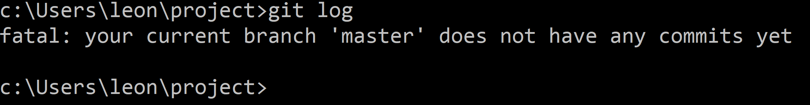
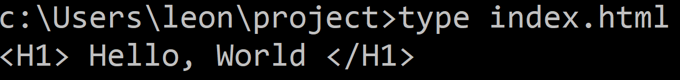
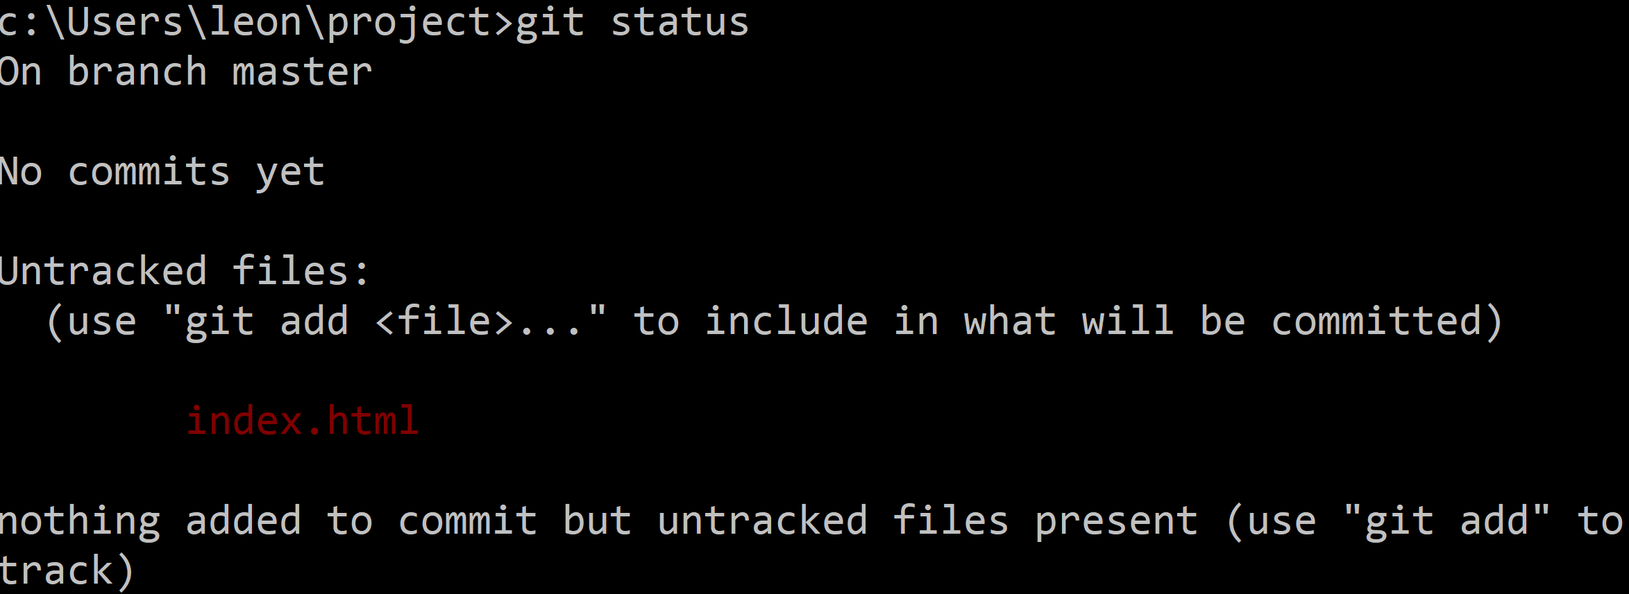
3) Check history of commits:
4) Create a file called “index.html”, with contents: <H1> Hello, World </H1>
5) Check status:

Slide 31
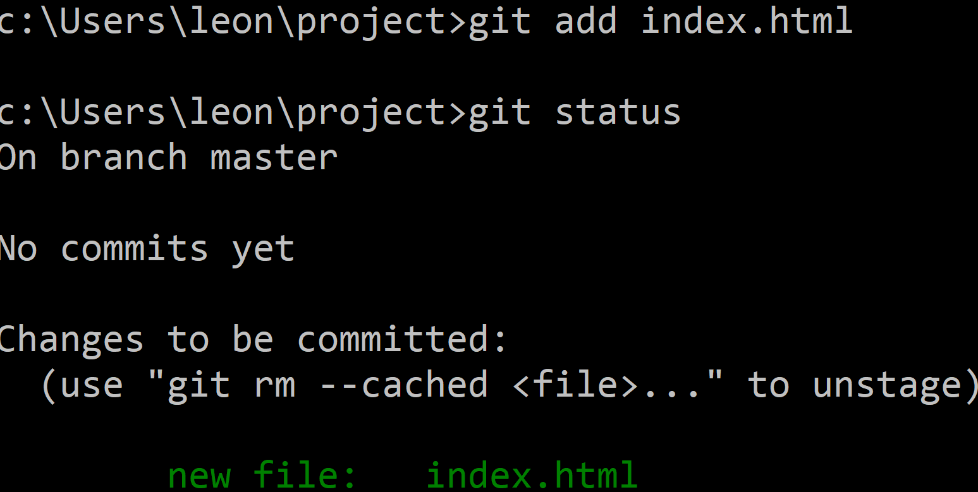


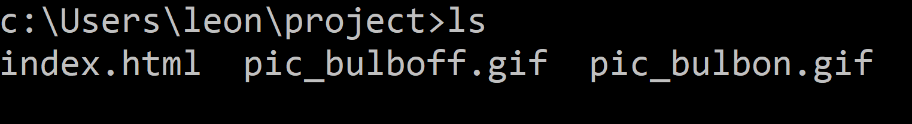
6) Add index.html to staging area, then check status:
To remove file from staging area, use git rm –cached index.html
7) Add the following two images to the folder (pic_bulboff.gif and pic_bulbon.gif):

Slide 32
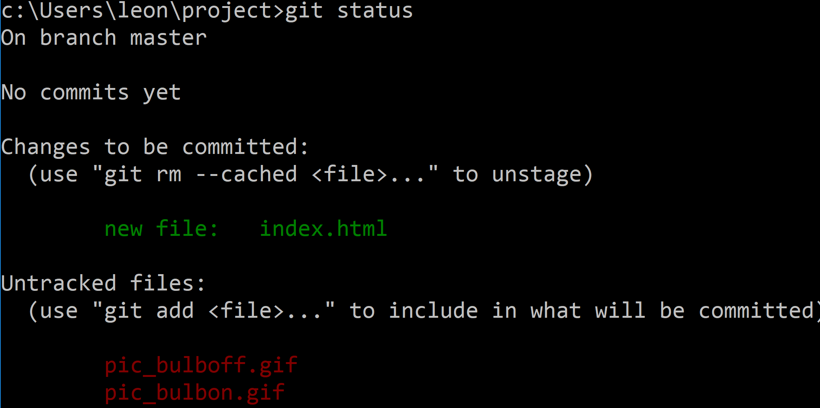
Status after staging index.html and adding two new files:

Slide 33
8) Modify the file index.html to be as follows:
<html>
<H1> Hello, World </H1>
<button onclick="document.getElementById('myImage')
.src='pic_bulbon.gif'">Turn on the light</button>
<img id="myImage" src="pic_bulboff.gif" style="width:100px">
<button onclick="document.getElementById('myImage')
.src='pic_bulboff.gif'">Turn off the light</button>
</html>
Save file index.html

Slide 34
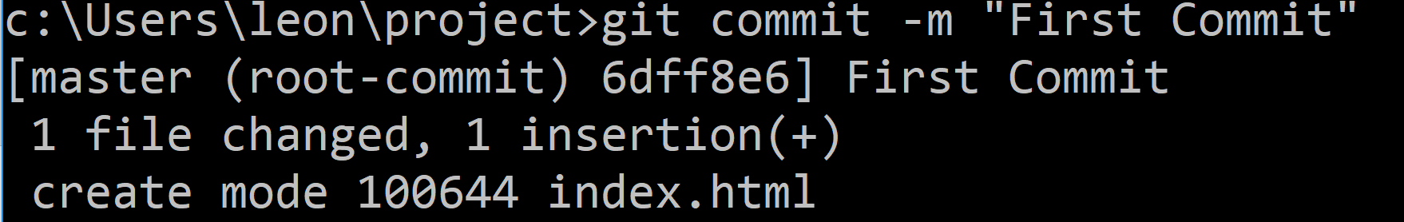
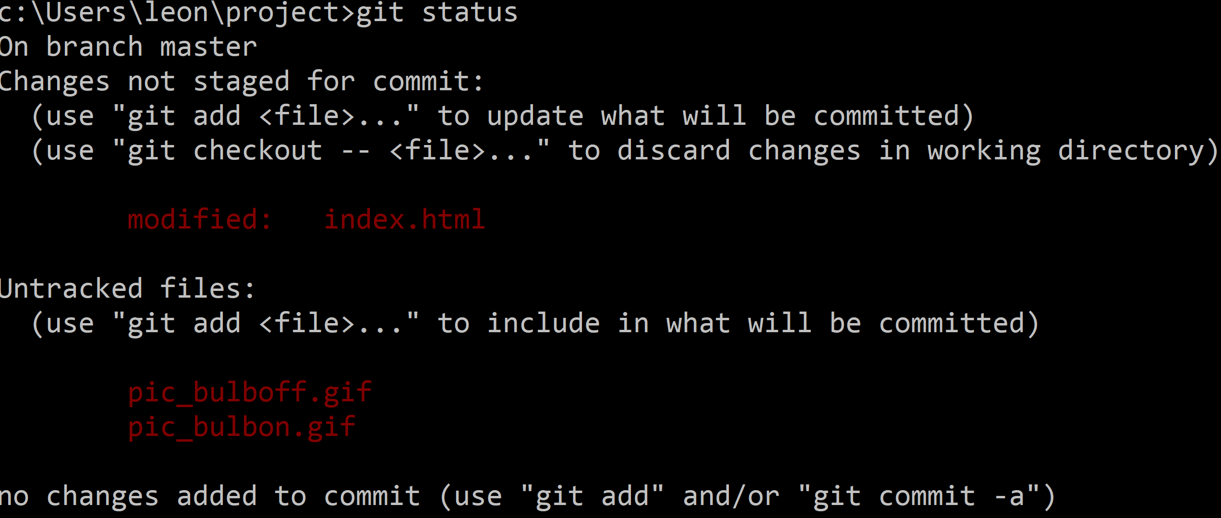
8) Commit file(s) in staging area:
9) Check status:

Slide 35
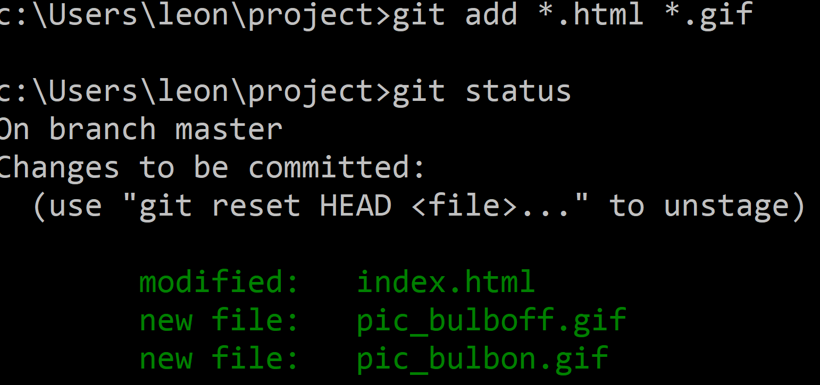
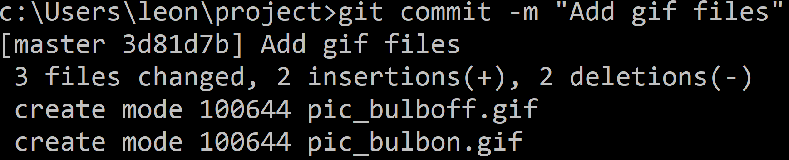
Status after staging index.html and the two .gif files:
Commit files in staging area:

Slide 36
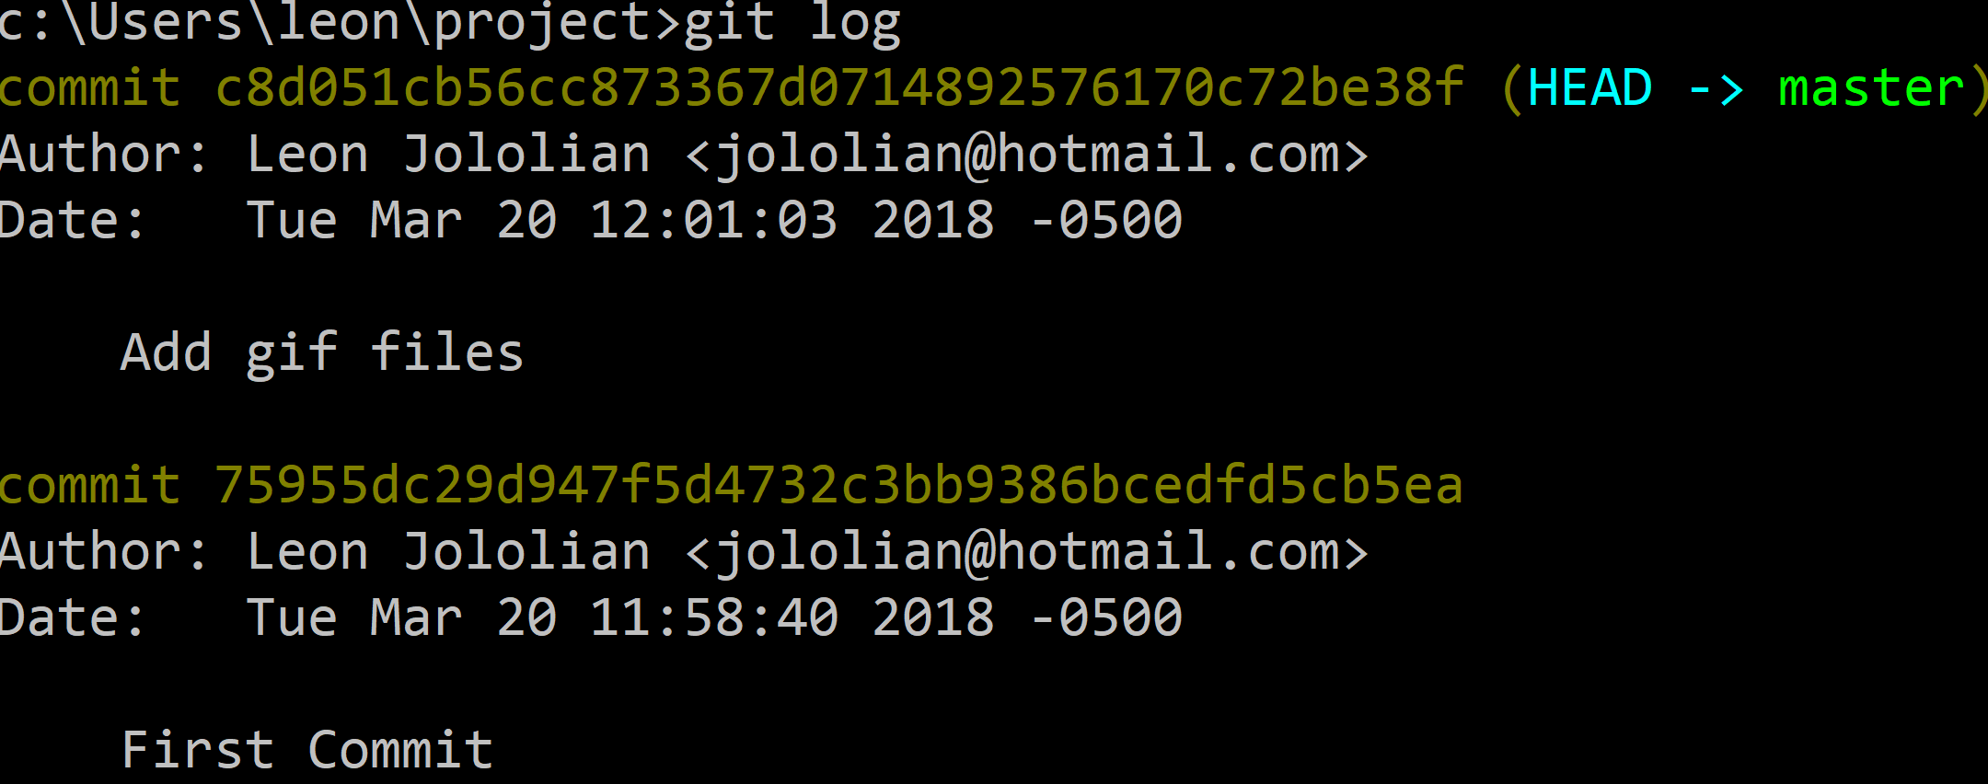
Output of the git log command:

Slide 37
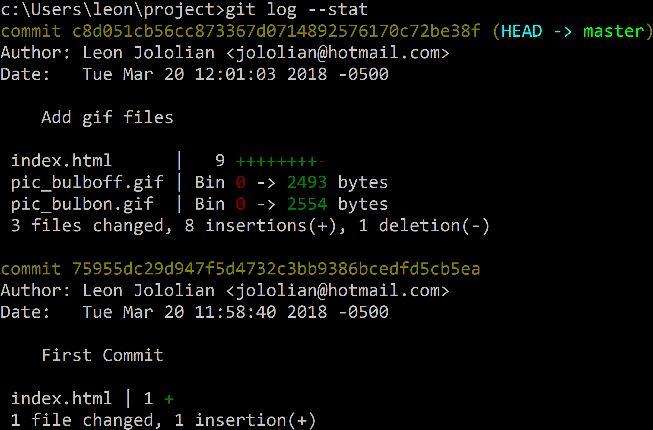
Output of the git log --stat command:

Slide 38
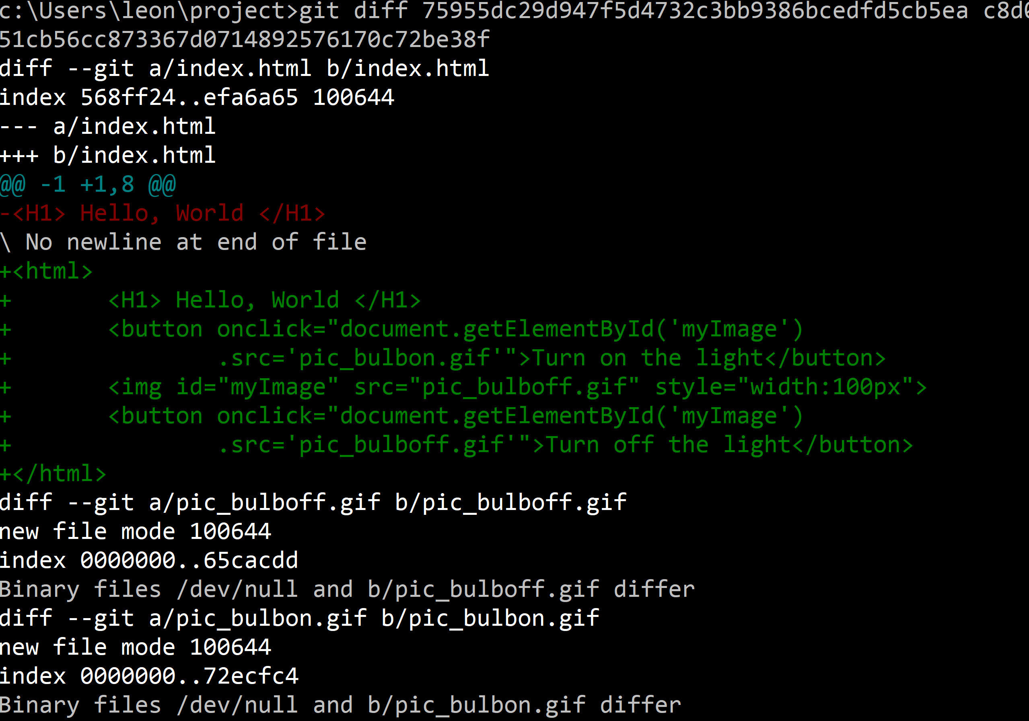
The git diff
Command:
Comparing different versions.

Slide 39
The git diff Command Options
git diff
compares working directory to staging area
git diff --staged
compares staging area to last commit
git diff <commit id1> <commit id2>
compares two previous commits

Slide 40
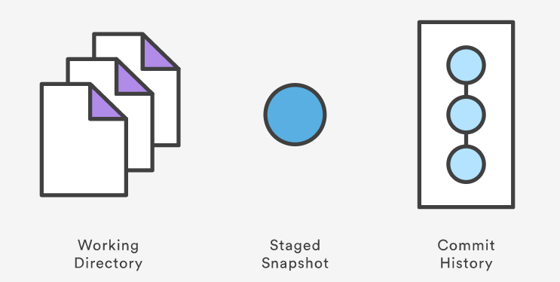
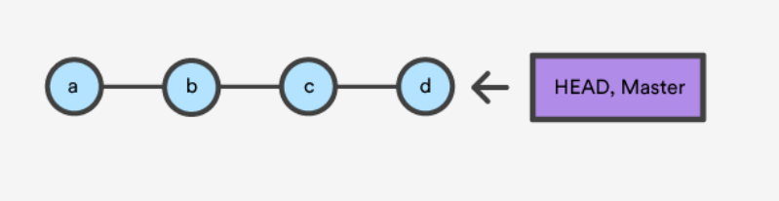
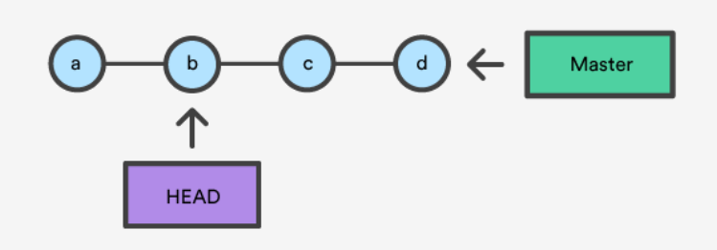
The working directory, the staged snapshot, and the commit history:
A checkout is an operation that moves the HEAD ref pointer to a specified commit:
After git checkout b:

Slide 41
Git Branching and Merging
Scenario:
Do some work on a website.
Create a branch for a new story you’re working on.
Do some work in that branch.
At this stage, you’ll receive a call that another issue is critical and you need a hotfix. You’ll do the following:
Switch to your production branch.
Create a branch to add the hotfix.
After it’s tested, merge the hotfix branch, and push to production.
Switch back to your original story and continue working.

Slide 42
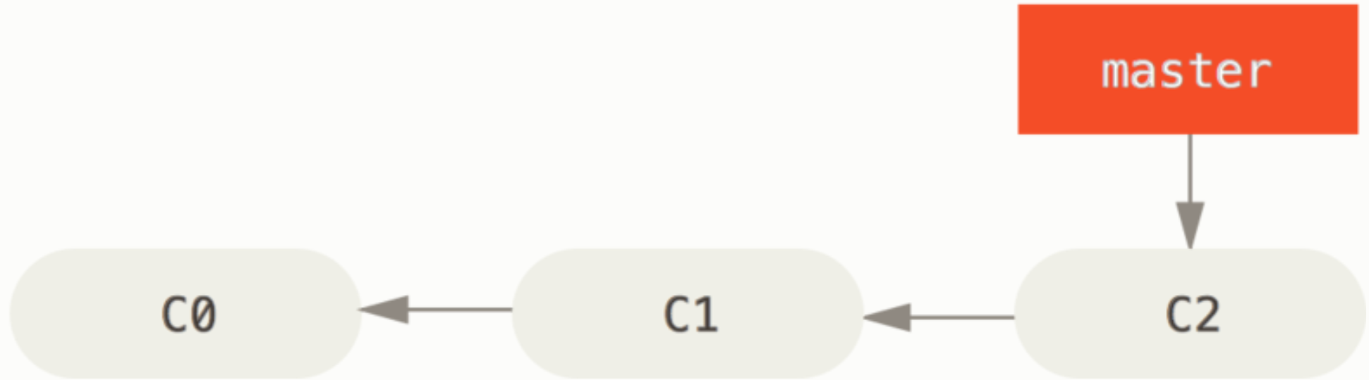
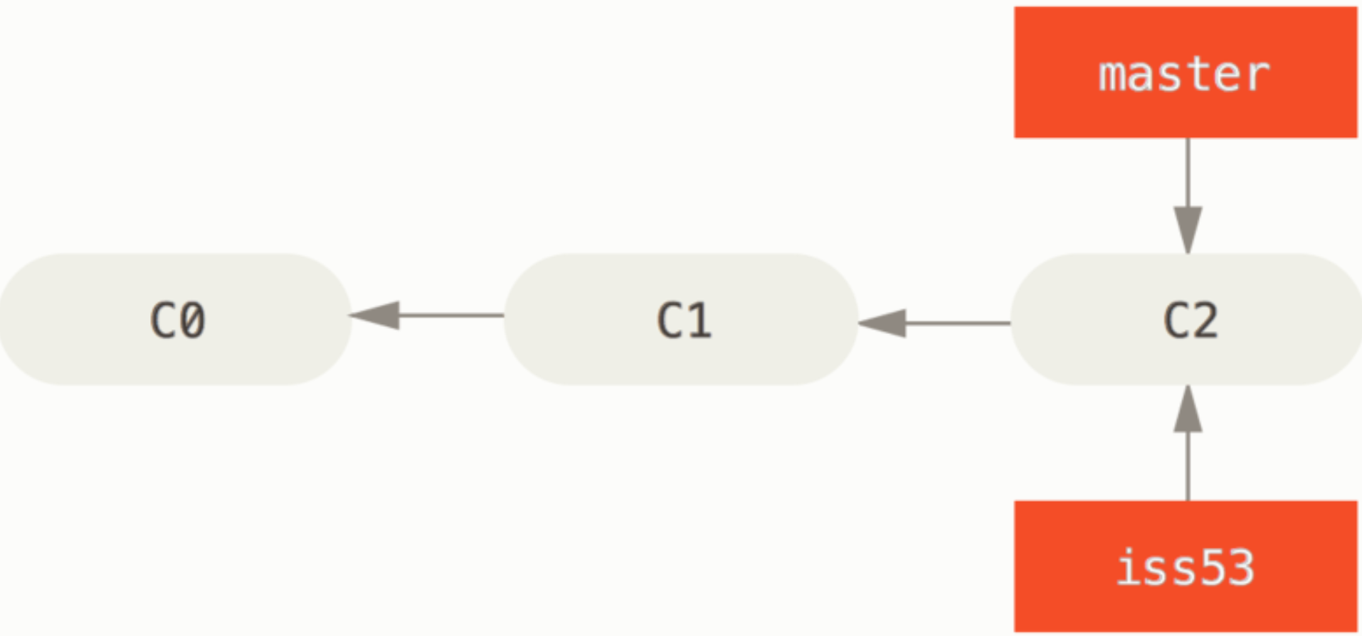
You’re working on your project and have a couple of commits already on the master branch.
You decide to work on issue #53. So, you create a new branch and switch to :
git checkout -b iss53
Same as,
git branch iss53
git checkout iss53

Slide 43
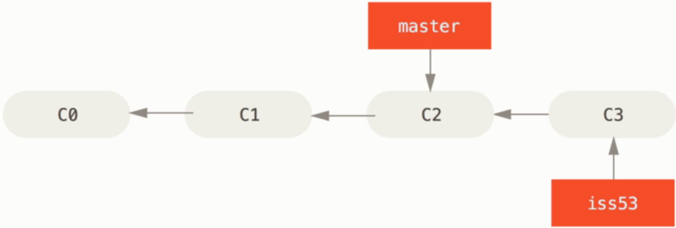
You work on your website and do some commits. Doing so moves the iss53 branch forward, because you have it checked out (that is, your HEAD is pointing to it):
vim index.html
git commit -a -m 'added a new footer [issue 53]'
Now you get the call that there is an issue with the website, and you need to fix it immediately.

Slide 44
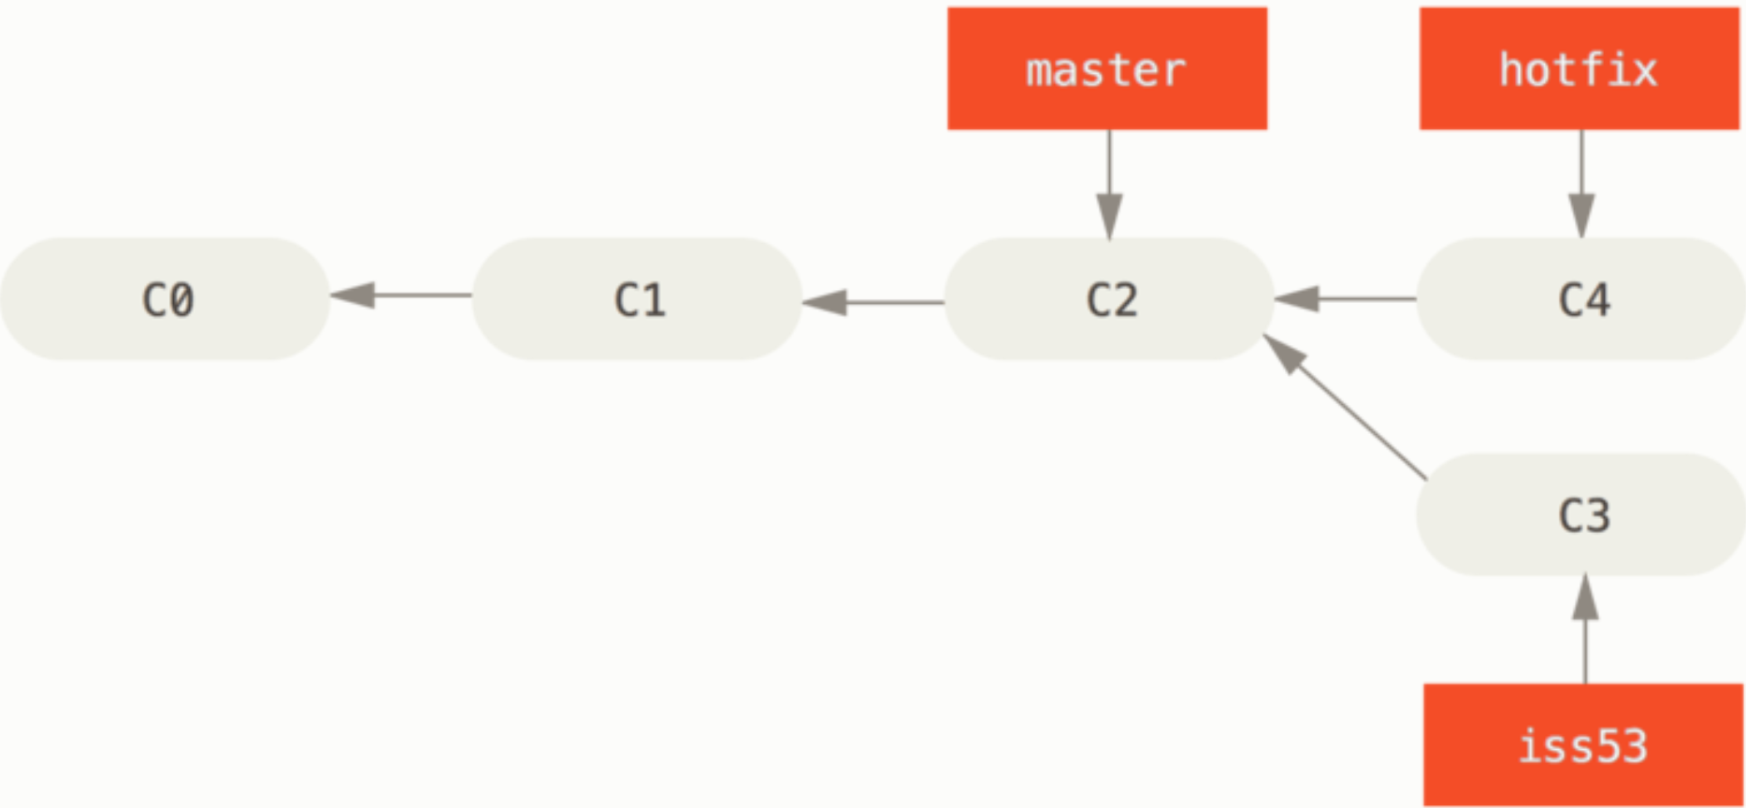
you commit all your changes, so that you can switch back to the master branch:
git checkout master
At this point, your project working directory is exactly the way it was before you started working on issue #53.
Next, you create a hotfix branch on which to work until it’s completed:
git checkout -b hotfix
vim index.html
git commit -a -m 'fixed the broken email address'

Slide 45
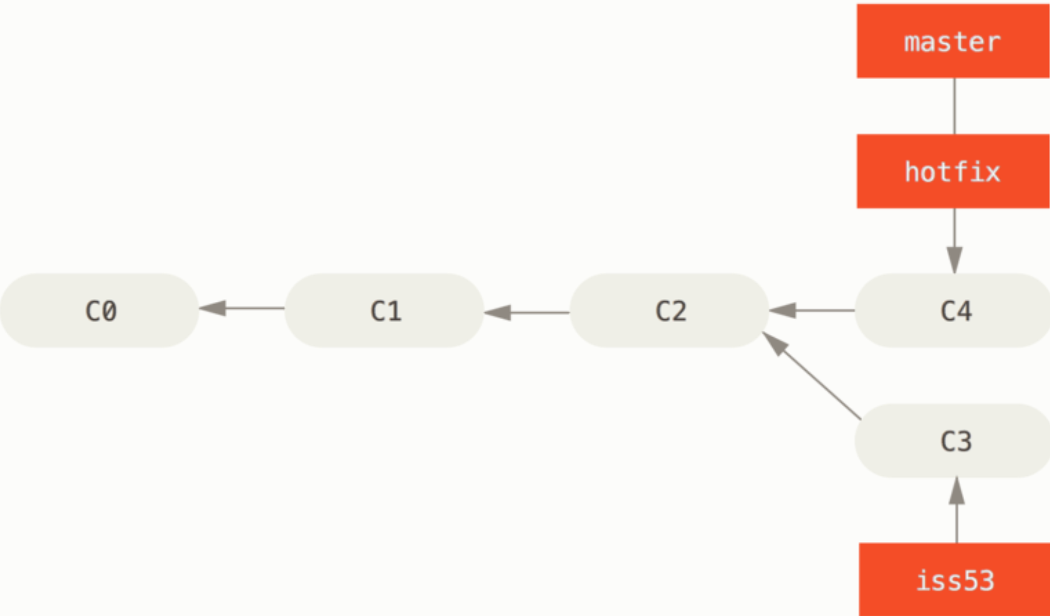
After making sure the fix works, merge the hotfix branch back into your master branch to deploy to production:
git checkout master
git merge hotfix
The change is now in the snapshot of the commit pointed to by the master branch, and you can deploy the fix.

Slide 46
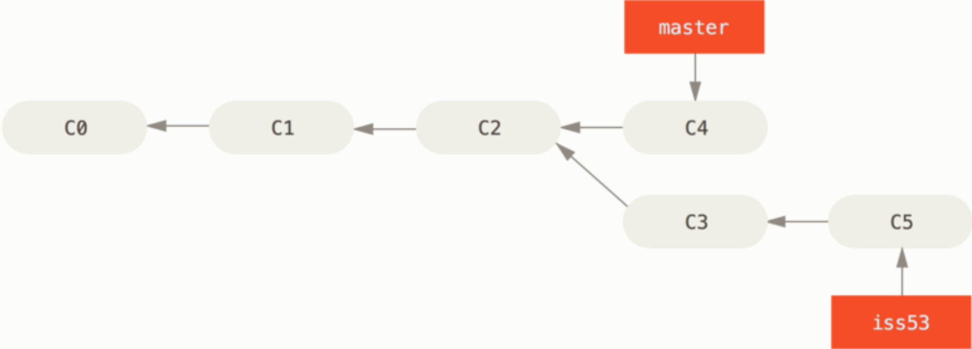
Switch back to the work you were doing before you were interrupted. However, first you’ll delete the hotfix branch, because you no longer need it — the master branch points at the same place.
git branch -d hotfix
Now you can switch back to your work-in-progress branch on issue #53 and continue working on it.
git checkout iss53
vim index.html
git commit -a -m 'finished the new footer [issue 53]'

Slide 47
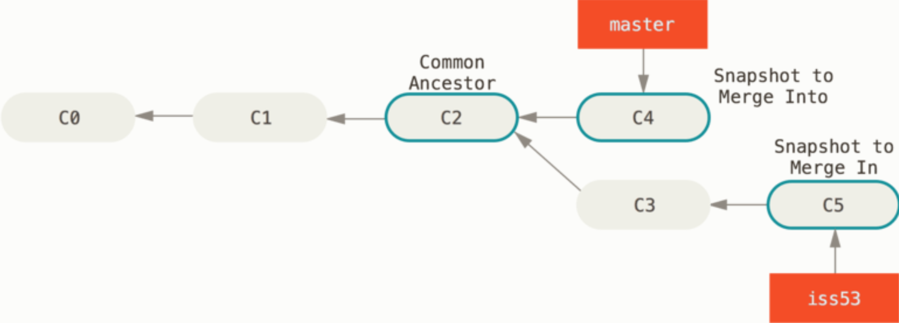
You decide that issue #53 is complete and ready to be merged into the master branch. so you’ll merge iss53 branch into master:
git checkout master
git merge iss53
In this case, your development history has diverged from some older point. Because the commit on the branch you’re on isn’t a direct ancestor of the branch you’re merging in, Git has to do some work. In this case, Git does a simple three-way merge, using the two snapshots pointed to by the branch tips and the common ancestor of the two.

Slide 48
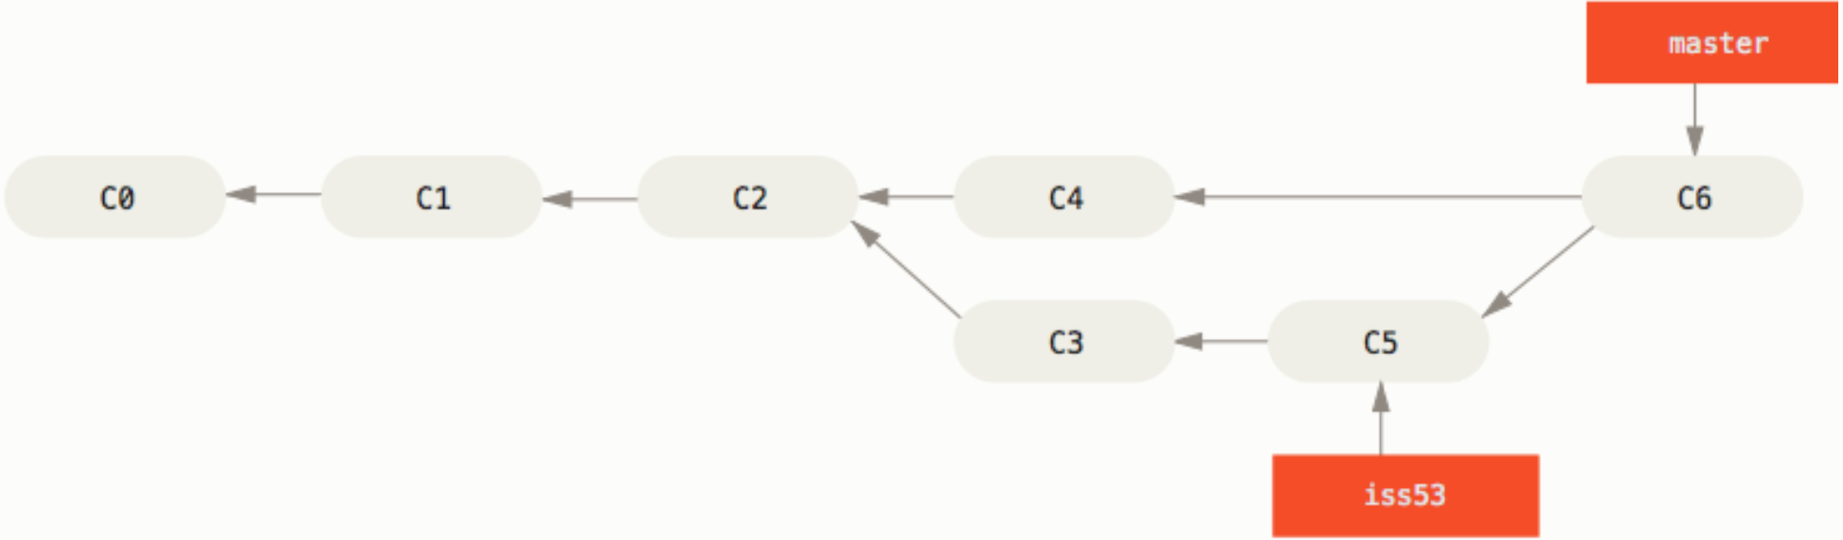
Instead of just moving the branch pointer forward, Git creates a new snapshot that results from this three-way merge and automatically creates a new commit that points to it. This is referred to as a merge commit, and is special in that it has more than one parent.
you have no further need for the iss53 branch. You can delete the branch:
git branch -d iss53

Slide 49
Setting up the git Bash Environment
Copy the file .bash_profile to the home directory
Copy the file git-completion.bash to the home directory
Copy the file git-prompt.sh to the home directory
Configure colors for git bash
To configure git to use a specific editor:
Find path to the editor
Type the command: git config –global core.editor “<path> -n –w”
To create the alias ed for your editor in Bash,add the line to your .bash_profile:
alias ed = “ <path to editor> “

Slide 50
.bash_profile
# Enable tab completion
source ~/git-completion.bash
# colors!
green="\[\033[0;32m\]"
blue="\[\033[0;34m\]"
purple="\[\033[0;35m\]"
red="\[\033[0;31m\]"
reset="\[\033[0m\]"
# Change command prompt
source ~/git-prompt.sh
export GIT_PS1_SHOWDIRTYSTATE=1
# '\u' adds the name of the current user to the prompt
# '\$(__git_ps1)' adds git-related stuff
# '\W' adds the name of the current directory
export PS1="$red\u$green\$(__git_ps1)$blue \W $ $reset"
alias t="C:/Program\ Files/TextPad\ 8/TextPad.exe"

